Slide 1
Creative and Streamlined Fundraising: How to Effectively Collaborate with your JDRF Partners.
ANTHONY GERACI
AUGUST 5TH, 2022

Slide 2
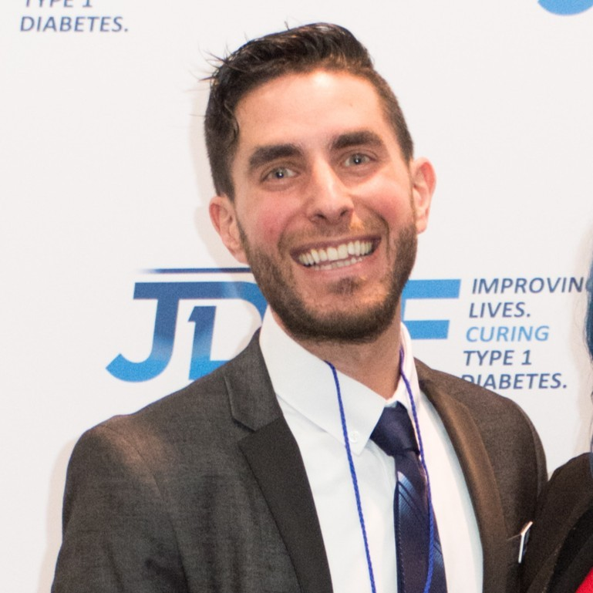
Anthony Geraci
National Director, Corporate Development
T1D Story
Introduction
Notes:
Take this moment to engage with your audience.
Why are you here to talk with them?
Why is this important to you?
Why is it important to them?

Slide 3
Agenda
Introduction
About Type 1 Diabetes (T1D)
About JDRF
Streamlined Fundraising
JDRF & DTD Handbook
Best Practices – Hear from your brothers
Q & A

Slide 4
ABOUT TYPE 1 DIABETES

Slide 5

About Type 1 Diabetes (T1D)
The onset of type 1 diabetes can happen suddenly, impacting people of any age, affecting them every moment of every day…
And it lasts a lifetime.
Notes:
Take a moment to explain; don’t assume your audience understands
T1D is an autoimmune disease in which a person’s own body begins attacking and killing the beta cells that produce insulin needed to maintain normal body function.
T1D seems to have a genetic component and can be diagnosed early in life, but also in adulthood. Its causes are there is currently no cure. People with T1D rely on insulin for the rest of their lives to not fully known, and survive.

Slide 6
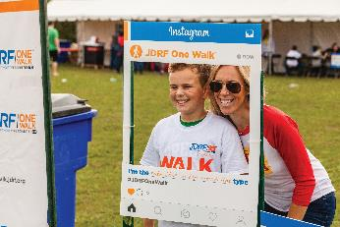
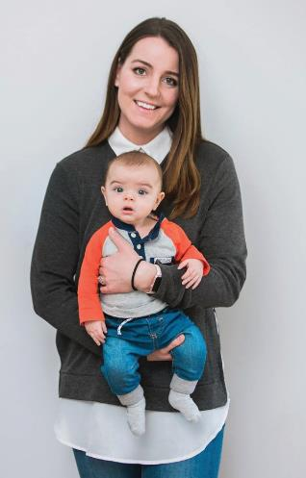
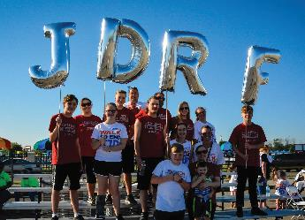
T1D is a Challenging Disease
It can lead to serious complications
Approximately 40-60% of people with T1D develop eye disease within 20 years of diagnosis
Of those living with T1D, 25-40% typically develop kidney disease
It can be difficult to manage
There are 188,000 hospitalizations for DKA – diabetic ketoacidosis – reported in the U.S. every year. A serious and life-threatening condition, it can develop even with careful monitoring
Notes:
Again, take a minute to bring them into the T1D world, it’s critical that your audience really understands the burden T1D carries
With T1D, the body becomes incapable of creating insulin, which converts sugar found in food, called glucose, into energy. People with T1D must work closely with their endocrinologists to determine when and how much insulin to take -- and the lifestyle changes needed to manage their blood-sugar levels.
If someone is not able to manage their glucose levels properly, they are vulnerable to health issues ranging from minor to severe.
Managing the levels is not easy. In fact, most people with T1D spend the majority of their time with blood-glucose levels outside the recommended healthy range, which can lead to potentially deadly episodes of hyperglycemia (high blood sugar) and hypoglycemia (low blood sugar).
Chronic high blood sugar often causes devastating health complications later in life, including blindness, kidney failure, heart disease and nerve damage that can lead to amputations.

Slide 7
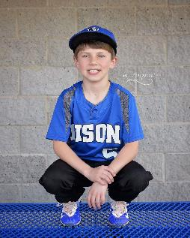
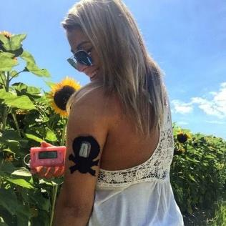
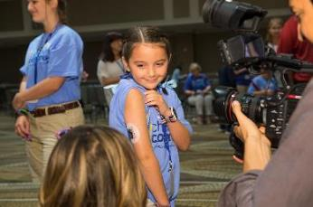
Helping Those with T1D Live Full Lives
Those with T1D need:
Advocacy for their needs to help drive advances to both cure the disease and help keep them healthy until cures
are found
Ongoing research for cures and treatments
Educational information and support
Access to good health care coverage, affordability and choice
Notes:
Now, introduce JDRF as a champion of the T1D Community.
It is because T1D is such a complex and trying disease, that JDRF was founded.
The T1D community has many needs in several different areas, and JDRF aims to do all we can to ensure people with T1D are getting the best education and support, access to the treatments they need, and continued research funding for cures and treatments.

Slide 8
ABOUT JDRF
Notes:
Help them understand who we are, what we do, how we work.

Slide 9
JDRF’s Purpose
Our Vision:
A world without T1D
Our Mission:
Improving lives today and tomorrow by accelerating
life-changing breakthroughs to cure, prevent and treat
T1D and its complications.
Notes:
Key Message: JDRF has fought to advance T1D research since our founding 50 years ago and we will not stop until we find a cure for type 1 ​diabetes.
​
Notes: ​
Throughout our 50-year history, JDRF has fought to advance type one diabetes science -- driving to find cures for T1D and improve lives. ​
Every time we saw a tangible promise, we relentlessly pushed forward, driving more funding, pulling in new researchers and propelling results. ​
This tenacity and vision led to the creation of the artificial pancreas (five years ahead of schedule), the continuous glucose monitor, and advances in beta cell regeneration and drugs that are delaying the onset of T1D.

Slide 10
Our Approach
JDRF is fighting to find cures for tomorrow, while improving the lives of those with T1D today through research, advocacy and community engagement.
JDRF RESEARCH
Curing T1D
Beta Cell Therapies
Immune Therapies
Improving Lives
Glucose Control Therapies
Complication Treatments
Outreach, Education, Support
JDRF ADVOCACY
Notes:
We bring a holistic and focused approach to driving that mission forward.
We focus on Research and harness Advocacy and Community Engagement to fight for cures and improve lives.

Slide 11
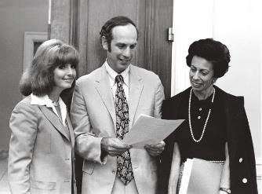

Our Story
Founded Nearly 50 Years Ago:
At a time when all we really knew was that our children were getting sick, JDRF was already creating a community of support.
Today:
JDRF is the single most powerful force and funder in the world driving T1D Research seeking both cures for tomorrow and treatments for today.
Notes:
How we started . . .
Since its founding by families just like many of us 50 years ago, JDRF has led the effort to find cures for T1D.
And in that time, JDRF has played a role in virtually every transformative change in T1D care.
As we look to the future, we continue to carry out our mission to accelerate life changing breakthroughs to find cures for T1D and improve lives.

Slide 12
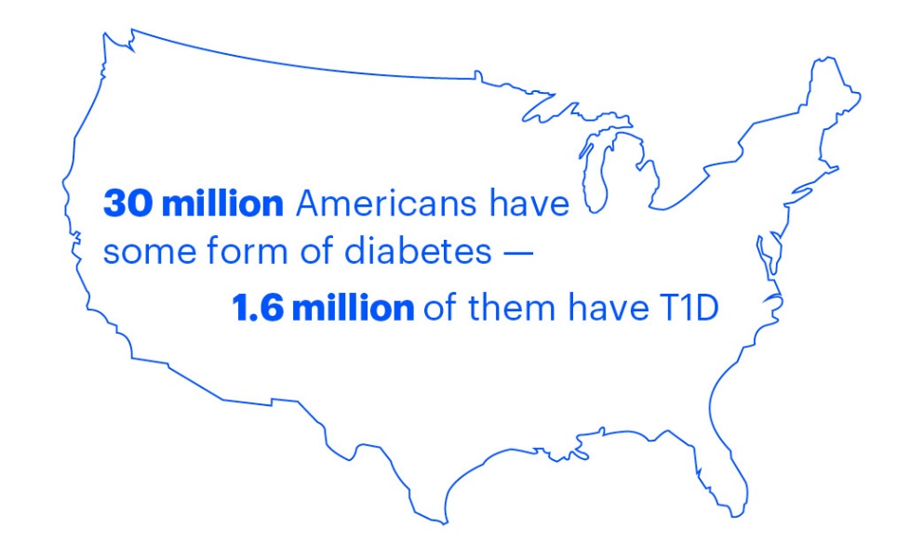
National Health Crises We are Solving for Together
At JDRF, our partnerships start with purpose and focus on impact. We strive to ensure our work together creates real results for our communities and drives measurable change.
5 million people are expected to have T1D by 2050 — including a threefold increase of youth cases
64,000 people are estimated to be diagnosed each year in the U.S.
Less than one-third of people with T1D in the U.S. are achieving target blood-sugar levels
More than $16 billion is spent on T1D-associated direct medical costs in the U.S.

Slide 13
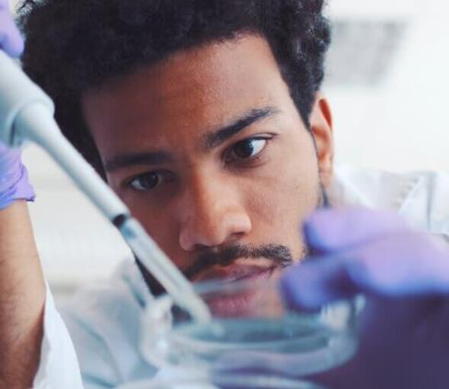
A Champion of the T1D Community
JDRF is the leading nonprofit fighting to find cures for T1D and improve the lives of those living with the disease today.
In fact, JDRF has played a role in nearly every major advance – drug, device, cell therapy – made in T1D in the last 50 years.
We work with researchers, foundations, universities and consortia all over the world, funding research in 21 countries.
We also invest, via the JDRF T1D Fund, in commercial projects showing promise of positively impacting the T1D community.
Notes:
How we’ve grown to do more . . .
Today, JDRF sets the global T1D research agenda and is the largest private funder of T1D research in the world, with over 180 grants annually in 21 countries.

Slide 14

Our Financial Support of T1D
We have raised $2.5B for research and secured another $2.8B from the U.S. Government.
No other nonprofit organization raises, invests or drives more funding to find cures for T1D.
Supporters raised $121.5M to advance research in FY19 - a 10-year high.
No organization is fighting harder to cure T1D.
14
Notes:
Over the years, we have invested $2.5B directly in research, advocacy and community engagement.
We also have worked with the U.S. government to raise another $2.8B over the last 2 decades.
No other organization is fighting harder to find cures for T1D.

Slide 15
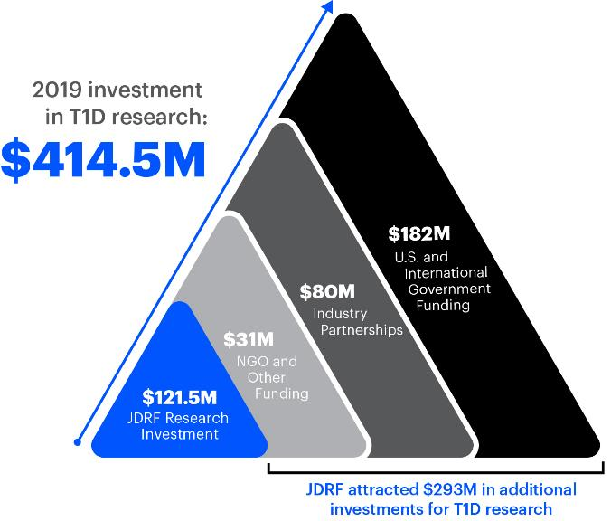
Our Impact on T1D Research
Two years ago, in addition to tracking
our grant funding, we began following
the additional investments we were able to secure through advocacy, influence and partnerships.
What we learned…
For every $1 from JDRF in grant funding, we are seeing
nearly an additional $2.50 invested in T1D research.
No organization is fighting harder to cure T1D
Notes:
Key Message: JDRF’s research investments do not tell the whole story. JDRF attracts hundreds of millions in additional research investments around the world. For every $1 JDRF invests in research, nearly an additional $2.50 are brought into the field.
Notes:​
No matter how generous our supporters are, the cost of funding all the promising research in front of us outstrips what we can realistically raise.​
That’s why a core part of our strategy is seeking innovative ways to leverage your dollars so they go even farther. ​
It’s working: in 2019, JDRF directly and indirectly attracted $414.5 million toward T1D research initiatives. Put another way, our impact on the T1D landscape goes far beyond our direct research funding.​
For every $1 JDRF invests in research, nearly an additional $2.50 is brought into the field through our efforts .​
To date, our direct funding, partnerships and advocacy have led to nearly $5 billion invested in T1D research and community support.

Slide 16
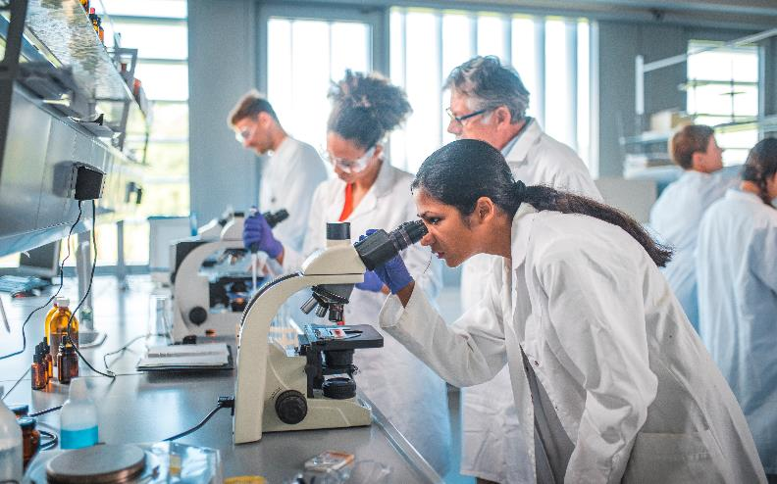
Innovating to Drive Meaningful Research
In late 2016, we saw a gap in moving encouraging therapies from discovery to commercialization, and into the hands of the T1D community.
Work was promising, but securing needed funding was a challenge.
We saw an opportunity to enroll more investors to advance our mission.
Notes:
And there is another way that JDRF is driving funding into the T1D space.
We realized in 2016 that there was a huge opportunity to help promising therapies move – and move faster – from discovery to commercialization.
And, to save some key work that without additional support may never progress….

Slide 17
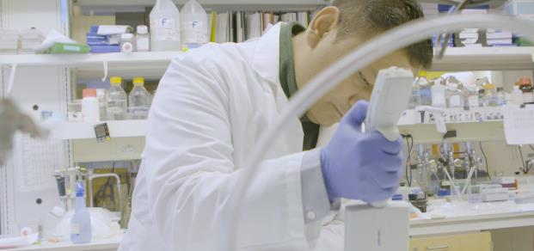
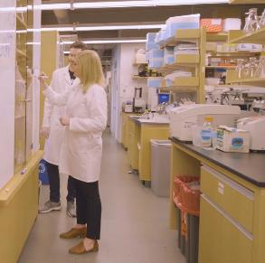
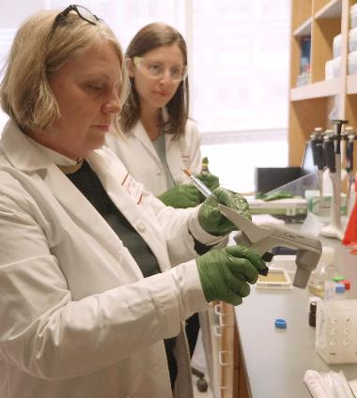

JDRF:
Driving Progress
Notes:
Key Message: JDRF has a clear strategy to help improve the lives of those affected by T1D and finding a cure. The following slides show how JDRF drives progress forward.

Slide 18
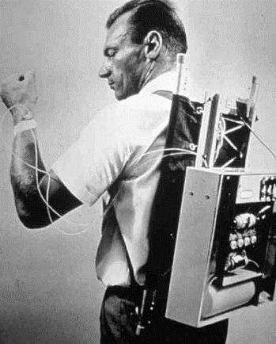

Then and Now
Treat
Blood glucose is
measured with
urine strips
The first synthetic insulins are developed
There are several hybrid closed-loop systems on the market that help
people with T1D do better
Notes:
Key Message: JDRF’s progress is not theoretical—there are tangible results that have changed how T1D is treated in the last 50 years. ​
Notes:​
These are just a few examples of progress built upon JDRF funded research.

Slide 19

Then and Now
Cure
There was no way of knowing who would develop T1D
Biomarkers are discovered to detect and track T1D before symptoms arise, avoiding adverse events
A drug that delays the onset of T1D by 2+ years
is in phase III clinical trials
Notes:
Key Message: JDRF’s progress is not theoretical—there are tangible results that are bringing us closer to finding cures for T1D. ​
Notes:​
These are just a few examples of progress built upon JDRF funded research.

Slide 20

Then and Now
Research
Human clinical trials were
few and far between
JDRF influence results in substantial investments in T1D research and development by top pharmaceutical companies
70+ clinical trials are currently underway in humans
Notes:
Key Message: JDRF’s progress is not theoretical—there are tangible results that have improved the lives of people living with type 1 diabetes.
Notes:​
These are just a few examples of progress built upon JDRF funded research.

Slide 21


How JDRF Makes an Impact
Currently Supporting
Committed Over
Awarded
Federal Funding
$2.5B
Cumulative Research Funding Since 1970
180
New Research Grants In 2019
$2.8B
T1D research funding through the Special Diabetes Program
70+
Clinical Trials
Notes:
Key Message: Today, JDRF sets the global T1D research agenda and is the largest private funder of T1D research in the world​.
​
Notes: ​
JDRF has a team that interacts with the leading T1D researchers around the world, identifying key research gaps, and facilitating scores of critical collaborations and data sharing vital to progress and problem solving. ​
JDRF has funded over $2.5 billion in research since inception, and $1.6 billion in last 15 years, in 21 countries.​
We are funding or supporting over 70 human clinical trials, which is 10 times more than a decade ago​.
Our commitment to clinical trials shows determination to translate discoveries to treatments and therapies that have a clinical impact on patients, such as lower A1cs, more time in range, fewer DKAs, less burdens, fewer complications. We are not about science projects; we are about delivering life changing therapies to patients on the path to delivering cures.

Slide 22
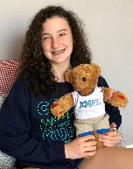



Improving Lives Through T1D Resources
Giving support, critical education and
outreach to our community
Every day, all around the world, JDRF volunteers, staff and community members provide a network of support for the T1D community. Together, JDRF is making a lifelong impact often at times of the greatest need.
Newly diagnosed individuals are provided with educational and other resource support in the Bag of Hope and T1D Care Kit
Outreach Volunteers are matched with someone in need
Volunteers from the Online Diabetes Support Team answer online questions
Chapters nationwide host TypeOneNation Summits - day-long, fun, educational, networking opportunities
Notes:
We try to connect with families as soon as possible after diagnosis.
Sometimes they reach out to us and sometimes we are led to them by someone in our existing network or community.
And then we strive to help them as long as they need, with any challenge or opportunity that they face.
We have the newly diagnosed Care Kits for children and adults.
Mentors or Outreach Volunteers will work on a 1:1 basis.
We have an Online Diabetes Support Team.
And we host TypeOneNation Summits to build networking and support for all ages.

Slide 23
ADVOCACY
Notes:
The third piece of our story is centered around working with Research and Community Engagement. JDRF Advocacy serves to amplify the voice of the T1D community.

Slide 24
Our Approach
JDRF is committed to coverage, affordability and choice for the T1D Community
JDRF RESEARCH
Curing T1D
Beta Cell Therapies
Immune Therapies
Improving Lives
Glucose Control Therapies
Complication Treatments
Outreach, Education, Support
JDRF ADVOCACY
Notes:
As Community Engagement helps bring Improving Lives to life, JDRF Advocacy serves as a base to support all we do.
JDRF Advocacy is focused on several initiatives:
Special Diabetes Program (SDP)
Medicare coverage of Continuous Glucose Monitors
Coverage2Control
Regulatory Engagement
Insurer engagement
Health Policy

Slide 25
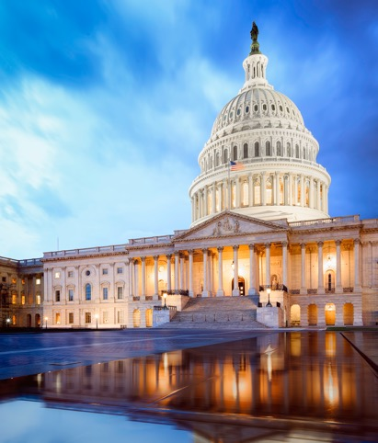
Advocacy
Launched to Secure Government Funding for T1D Research
By taking T1D stories and needs to Congress, JDRF Advocacy has secured and driven more than $2.8 billion for T1D research in 21 years through the Special Diabetes Program (SDP).
SDP has supported and enabled numerous breakthroughs in research and advances for the T1D community.
Notes:
First, let me tell you a bit about SDP – this is critical support that JDRF advocacy drives for all T1D research.
The Special Diabetes Program secures Federal funding for T1D research.
Advocacy builds awareness among Members of Congress of the financial, medical and emotional costs of the disease.
Our advocacy efforts have led to Congress approving nearly $97 million for the SDP since October 1, 2019, and the groundwork has been laid for a full renewal of the SDP in 2020.
Over the last 21 years, Advocacy has secured and driven more than $2.8 billion for T1D research through SDP.

Slide 26


Advocacy
The Community’s Needs Have Grown Quickly…
Medical expenses for people with T1D are 3 times higher than for people without diabetes
Over a 10-year period, the cost of insulin increased threefold
1.6 million Americans risk losing healthcare coverage if T1D is not a protected pre-existing condition
Notes:
That's the work Advocacy was originally created to do – secure Federal funding support.
But over time, we saw the needs of the T1D Community grow.
Medical expenses for people with T1D are 3 times higher than for people without diabetes.
Over a 10-year period, the cost of insulin increased threefold.
1.6 million Americans risk losing healthcare coverage if T1D is not a protected pre-existing condition.
And we knew we were in a unique position to do more, and that the community needed us to do more.

Slide 27
Advocacy
Coverage Ensure T1D remains a protected pre-existing condition so that no one with T1D can be denied coverage due to their disease
Affordability Manage the out-of-pocket costs for insulin and other tools so they remain predictable and reasonable
Choice Give people access to all life-saving technology, from continuous glucose monitors (CGMs) to artificial pancreas systems
Notes:
Today, Advocacy serves as the passionate, unrelenting voice for the T1D Community, calling for:
Coverage
To preserve protections for those with pre-existing conditions with access to comprehensive health insurance at rates similar to people without such conditions.
So that young adults can stay on their parents’ insurance until the age of 26.
That would prohibit insurance companies from setting annual and lifetime dollar limits.
Support to close the coverage gap in most Medicare prescription drug plans.
Affordability
All people with T1D should have affordable access to insulin.
JDRF is passionately advocating on the T1D community’s behalf and working with insulin manufacturers, health insurance providers, pharmacy benefit managers and employers to make sure that insulin is affordable to those who need it.
Choice
At the same time, people with T1D need the continued scientific innovation that has led, and will continue to lead, to more effective management and care.
JDRF champions:
Coverage (AP, CGM)
Choice (insulin pumps, insulin)
Helping people with T1D navigate the health system by providing toolkits and resources.

Slide 28




Advocacy
Giving the Community a Voice, Driving Change
25 of America’s largest health insurance companies agreed to cover the first closed-loop AP system.
Secured national attention and sparked positive debate over United Healthcare’s decision to cover just one type of new insulin pump, limiting choice for the T1D Community.
Saw the defeat of legislation that would
have allowed insurance companies to raise premiums for people with pre-existing conditions.
Work here continues.
Drove FDA understanding of Open Protocol (OP), leading to new regulatory and legal frameworks for OP systems.
Notes:
Please select from all the information shared here what will be of most interest to your audience. It is not necessary to share all of the information with every group you engage with. Be selective and know your audience.
The impact we are having is real.
Artificial Pancreas Coverage:
The first insulin dosing system was approved by the FDA in 2016 and came on the market in 2017, with additional versions to follow.
JDRF has successfully advocated to private insurers for coverage for these groundbreaking devices, and now the 25 largest plans cover them.
UnitedHealthcare:
People with T1D should have access to the diabetes management tools that are prescribed by their doctor and work best for them. JDRF strongly opposes health plan policies that limit choice of insulin pumps or CGMs, and advocates for a competitive marketplace that fosters innovation. JDRF strongly opposes additional limitations on insulin pumps put in place in early 2019 by the nation’s largest private insurer, UnitedHealthcare, which limits options for children and adults age 7 and older.
Pre-Existing Conditions:
One of JDRF’s healthcare principles is preserving protections for those with pre-existing conditions.
Individuals with pre-existing health conditions should have access to comprehensive health insurance at rates similar to their counterparts without pre-existing health conditions.
Open Protocol:
To support technological advancements, JDRF has advocated for an additional regulatory pathway for open protocol artificial pancreas components – those from different manufacturers that are interoperable with each other.
The FDA advanced JDRF’s call for an open protocol environment, which will allow for more options in artificial pancreas devices and thus improved outcomes. The FDA created the “ACE” pump designation and cleared the Tandem® t:slim X2™ insulin pump as the first in the category.
JDRF continues to work with the agency and the community to shape additional pathways for open protocol artificial pancreas components.

Slide 29
Insulin Affordability is a Top Priority for JDRF
No one should go without insulin because of cost.
Reports that insulin prices tripled over a 10 year period.
JDRF focus:
  End the drug rebate system that drives up list prices
  Improve plan benefit design to provide insulin at a low, fixed out-of-pocket cost
  Share resources to help with costs through www.jdrf.org/insurance
We are actively advocating to insulin manufacturers, government, health plans and employers.
Notes:
JDRF statement released 1/4/20:
JDRF Calls for Bipartisan Action on Insulin Affordability
“Tonight, as President Trump and the Congress gather in the Capitol for the State of the Union address, we need real, tangible, bipartisan action on insulin affordability.
No one should go without the insulin they need to stay alive or the devices they need to dose it effectively. Important programs exist now to help with costs, but we need manufacturers, health plans, employers, and the government to make systemic changes to make insulin affordable to all.
Numerous proposals have been introduced in Congress that would lower the cost of insulin. We urge Congress and the President to work together to enact bipartisan legislation as soon as possible to address this issue. In addition, policymakers should prioritize renewing the Special Diabetes Program and protecting people with preexisting conditions.
Health care access is a top priority for JDRF, and we will continue to fight for coverage, affordability, and choice so that people with type 1 diabetes can lead healthier lives until there are cures for this disease.”

Slide 30
THE COMMUNITY’S WORK TO SUPPORT US
Notes:
We could not do any of this – supporting and reaching more than a million people across the country – without JDRF’s generous supporters.
Here's a quick look at the many ways people support JDRF.

Slide 31

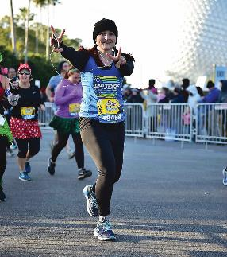

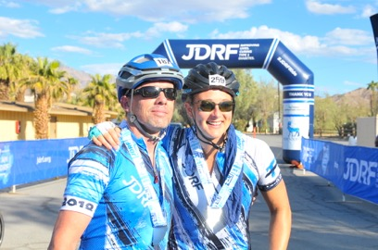
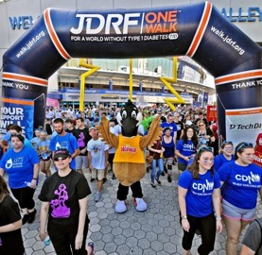
So Many Options to Drive Change
JDRF One Walk®
The funds raised by JDRF One Walk®–our flagship fundraising event and the largest T1D event in the world– help us turn Type One into Type None.
Fundraise for
JDRF…Your Way
Your favorite hobby, talent, passion or unique idea becomes a fundraiser.
JDRF Ride
Bike riders reach personal goals as they fundraise. Throughout their journey riders are surrounded by their T1D community–fellow riders, coaches, friends and family.
Team JDRF
provides entry into some of the country’s most exciting challenge events and is designed for JDRF supporters of all fitness levels.
Gala
Enjoy dinner, cocktails, first-class entertainment and auctions, while supporting JDRF’s mission through
Fund A Cure.

Slide 32
JDRF GAME2GIVE
Notes:
We could not do any of this – supporting and reaching more than a million people across the country – without JDRF’s generous supporters.
Here's a quick look at the many ways people support JDRF.

Slide 33

What is JDRF Game2Give®?
JDRF Game2Give brings the video game community together to fundraise and spread awareness for type 1 diabetes (T1D). The program was founded in 2019 by game industry veterans who are also T1D parents, and has raised nearly $2.5 million to date.
CURE
PUNCH
KICK

Slide 34


Charity streams on Twitch are a great way to fundraise
Not just video games! Music, art, crafts, D&D, etc
Game2Give supports w/ a host of resources
(at left and at JDRF booth)
Past DTD campaigns showed impact and creativity
(@AwesomeBlueMan graphic below)

Slide 35
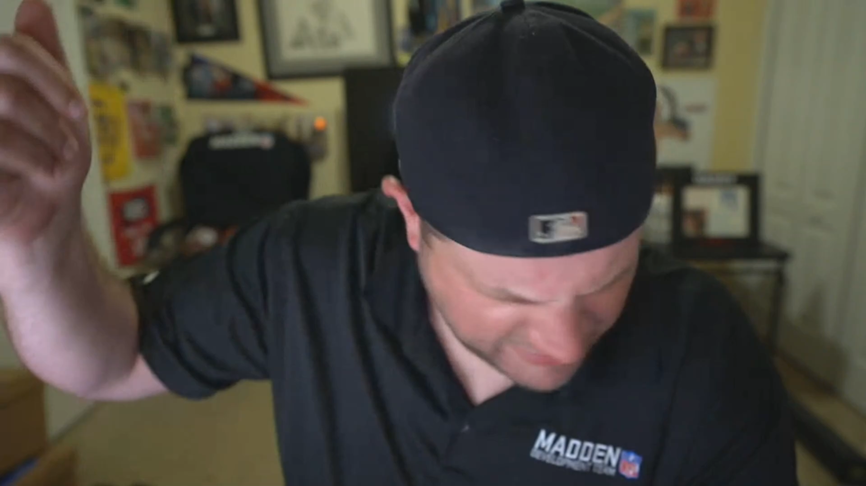
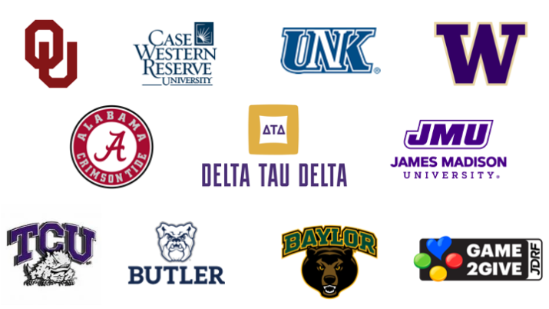
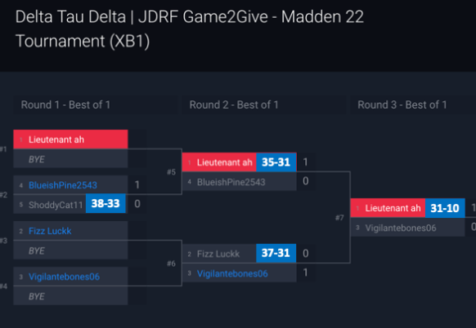
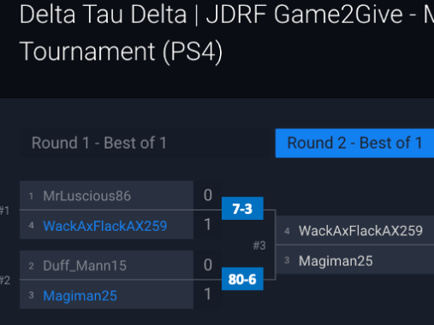
Madden Tournament (Year 1):
In April 2022, nine Delta Tau Delta chapters faced off in a Madden 22 community tournament on both PlayStation and Xbox.
The tournament culminated with a Twitch livestream hosted by RG Glick and OneGreatUser – Madden influencers within the gaming community.
Chapters were encouraged to fundraise alongside the tournament, which resulted in almost $3,500 raised for JDRF in total, with over $1,000+ coming from the Theta Delta chapter at Baylor!
Notes:
PLAY Madden clip: (uploaded from computer): https://clips.twitch.tv/CloudyBrightYakKeepo-OSaj9BZX6x5aZcHH
Madden NFL is a long-running series of football games made by Electronic Arts, named after legendary football coach and commentator John Madden. A new installment releases each year, with real-world player statistics and playbooks incorporated.
The JDRF Game2Give Madden 22 tournament had two brackets, PlayStation and Xbox. The competition started with chapters selecting a champion to represent them in the tournament. Some chapters had ten or more members competing for that spot, while others put forward an undisputed Madden GOAT. Chapter champions then went head-to-head to determine who went to the championship game. Participating chapters were encouraged to fundraise alongside the tournament, which resulted in almost $3,500 raised for type 1 diabetes research across the event.
JDRF was an important cause to John Madden, who died in December at age 85. His grandson has type 1 diabetes, and the Madden family are longtime JDRF supporters. The cause is also personal to RG Glick, the Madden Competitive Gaming Community Manager, whose fiancée lives with T1D.
RG and Madden influencer OneGreatUser hosted the PlayStation bracket’s championship game on Twitch on April 24. Playing as the Arizona Cardinals, Matthew Bridge of Kappa Beta (James Madison University) competed against Alex Schmidt of Theta Kappa (University of Nebraska at Kearney) playing as the Kansas City Chiefs. Matthew won the match 50–12.

Slide 36
JDRF & DTD Handbook
Notes:
We could not do any of this – supporting and reaching more than a million people across the country – without JDRF’s generous supporters.
Here's a quick look at the many ways people support JDRF.

Slide 37

2022 PARTNER HANDBOOK
Welcome Letter
JDRF & DTD Chapter Engagement
What to Expect from your DTD Chapter
Revenue Tracking
Social Media
DTD Chapter Listing
Chapter Map
JDRF Mailing Locations
DTD Contact Information

Slide 38
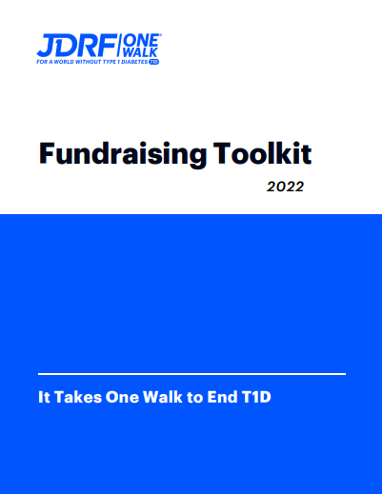
2022 FUNDRAISING TOOLKIT
JDRF ONE WALK
Goal Setting
Asking for Support
Fundraising Online
Fundraising with Facebook
Fundraiser Ideas
JDRF App
Customizing your Fundraising Link
Creating a QR Code
Matching Gifts
Additional Resources
Fundraising Incentives

Slide 39
facebook.com/myjdrf
ANTHONY GERACI
@JDRF
National Director, Corporate Development
@JDRFHQ
ageraci@jdrf.com | 312.447.2323
youtube.com/user/jdrfonline

Slide 40
APPENDIX

Slide 41
Welcome
JDRF Walk Name
HOSTED BY
Corporate Chair / Family Name

Slide 42
Agenda
Opening Remarks
Why We Walk: What life with T1D is like
JDRF Focus & Progress
Win-Win Partnership: Steps to get started
Closing Remarks

Slide 43
Mission Moment
  Speaker 1
  Name
  Title/Company
  OR
  Family Name
Place Image Here
Note: Fit this Mission Moment in where it makes the most
sense for your CRE/speaker opportunity!

Slide 44
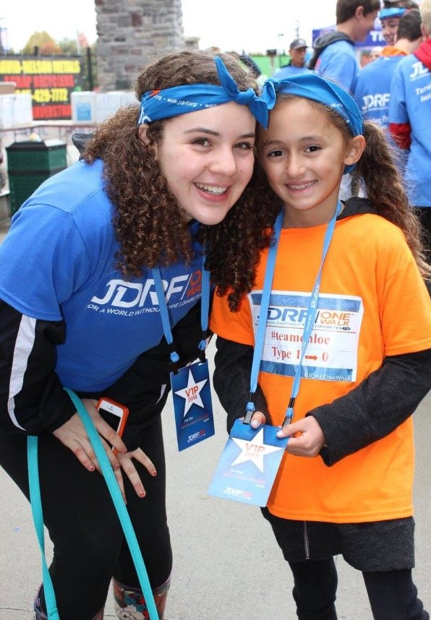
About Type 1 Diabetes
  Chronic autoimmune disease
  Unpreventable and incurable
  Nothing to do with diet or lifestyle
  24/7 disease requiring constant management
  Blood-sugar levels measured through finger pricks or continuous glucose monitor
  May still experience dangerous high or low
  blood-glucose levels

Slide 45
Know the Difference
Diabetes causes kidney, eye, heart, and nerve diseases.
Complications are not inevitable. Tight blood-sugar control is the only method demonstrated to reduce the risk of developing complications.

Slide 46
Type 1 Diabetes: A Quick Status Report

Slide 47
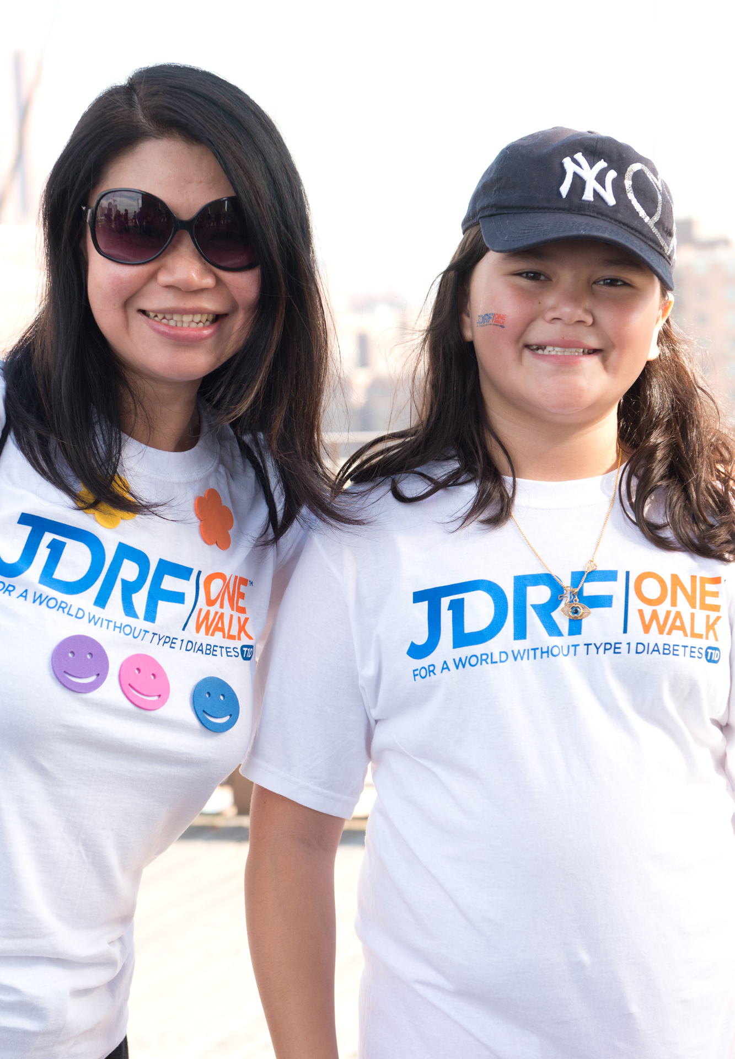
About JDRF
Our Vision:
A world without T1D
Our Mission:
Improving lives today and tomorrow by accelerating
life-changing breakthroughs to cure, prevent, and
treat T1D and its complications.
Notes:
JDRF has played a role in nearly every major T1D advance made in the last 50-plus years. These breakthroughs—including drugs, devices, and cell therapies—are now helping people with T1D live longer, healthier lives.
JDRF uniquely harnesses the power of research, advocacy, and community engagement to advance life-changing breakthroughs through the entire length of the T1D research and development pipeline.

Slide 48
JDRF’s Unique Approach
Notes:
What do we mean when we talk about the T1D research and development pipeline? The “pipeline” is the process by which new or improved therapies are created, brought to market, and ultimately lead to positive health outcomes. The full pipeline includes every step required to discover breakthroughs to cure T1D and improve lives PLUS every step required to get those breakthroughs into the hands of people with T1D as quickly and as affordably as possible.
In other words, new therapies have to make it from bench (discovery) to bedside (marketplace), PLUS they need to be covered by insurance companies such that they are as affordable as possible and such that people with T1D can choose which therapies and technologies work best for them...
ADDITIONALLY, health care providers and people living with T1D need to be educated about these breakthroughs so that clinicians and people with T1D are fully aware of the options for achieving better health outcomes. To advance our mission, JDRF actively works across all of these crucial pieces of the pipeline.

Slide 49
JDRF’s Progress Over 50+ Years

Slide 50

Accelerating Life-Changing Breakthroughs
$2.5 billion in research funding since 1970
CURE
PREVENT
TREAT
Restoring Insulin Independence
Preventing Symptomatic T1D
Improving Glucose Control

Slide 51
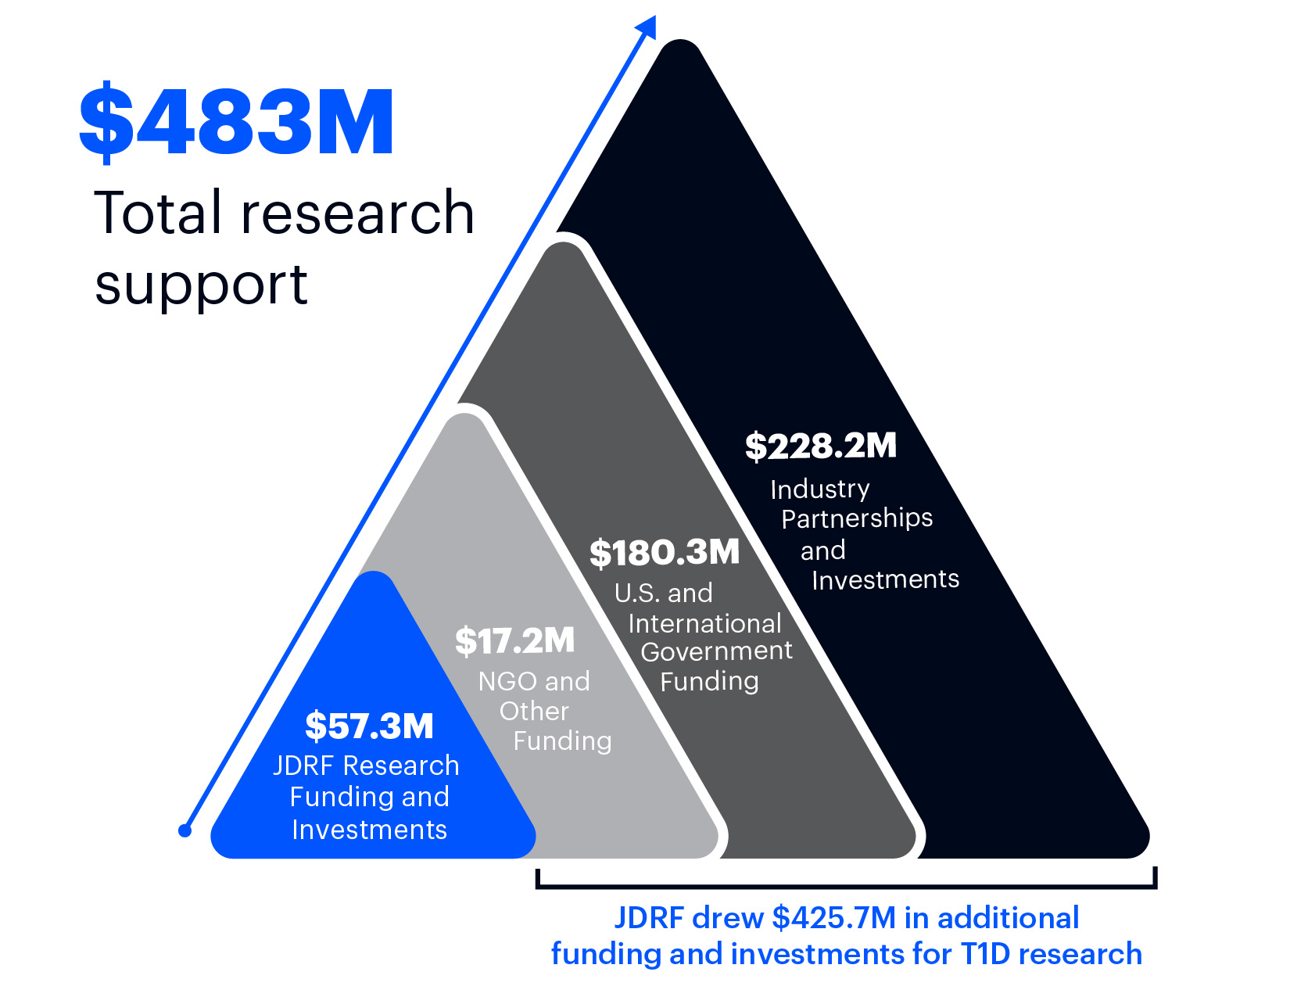
JDRF:
A Leader With Leverage
Notes:
Outside of our total research support for FY21 ($57.3M, which includes research grants and support, advocacy, and investments) we leveraged our expertise, advocacy efforts, and partnerships to drive even more dollars to T1D research and therapy development.
This year, through our efforts, as well as our work with other organizations, industry partners, and governments, we globally leveraged nearly half a billion dollars ($483 million) to T1D research and therapy development.
This “leverage”, as we call it, is a key part of our strategy to accelerate cures and life-improving therapies. To accelerate our mission to cure T1D and improve the lives of those living with it, we know we need to collaborate with like-minded organizations. T1D is a complex disease and unraveling solutions and cures requires a strategic, focused effort by many.

Slide 52
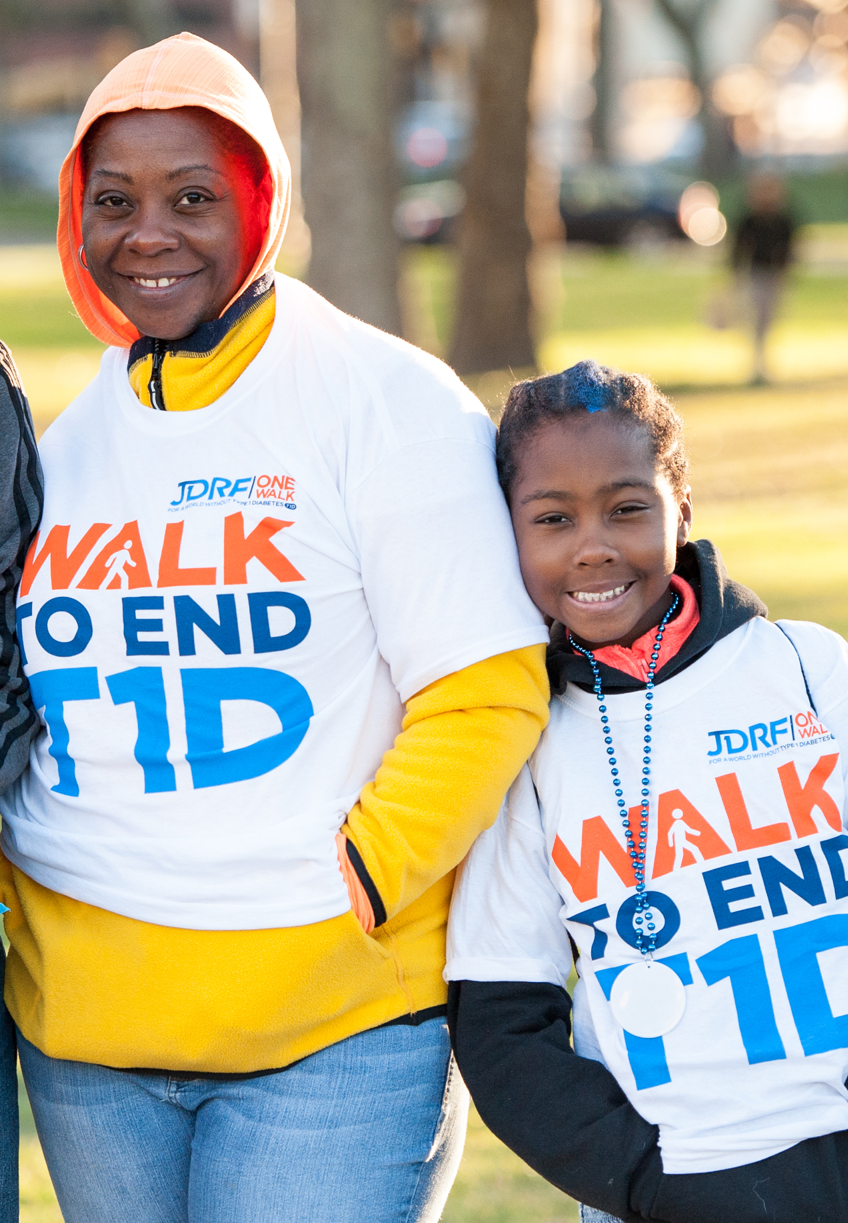
Partnering With JDRF Makes Good Business Sense
  Celebrate your Loved Ones
  Differentiate Yourself from Competitors
  Enhance Brand Awareness
  Contribute to a Cure
  Boost Health and Wellness
  Increase Employee Engagement
  Meet Corporate Social Responsibility Goals
  Drive Customer Loyalty
  Build Your Brand Image
  Help Change Lives

Slide 53
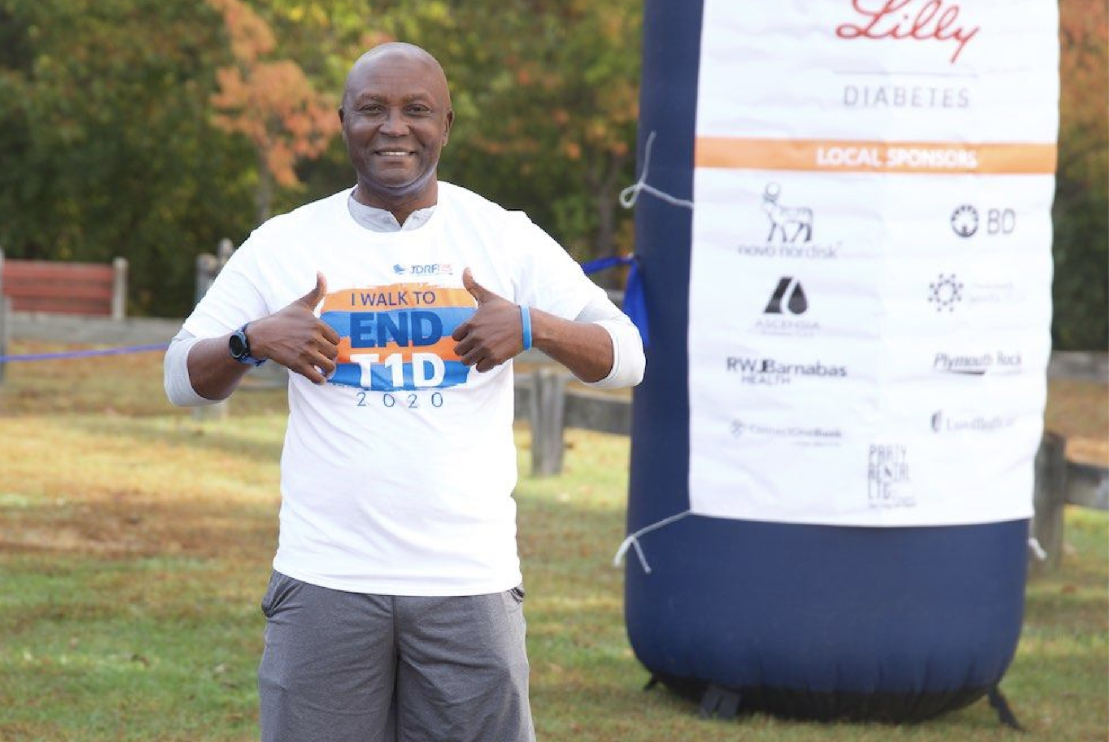
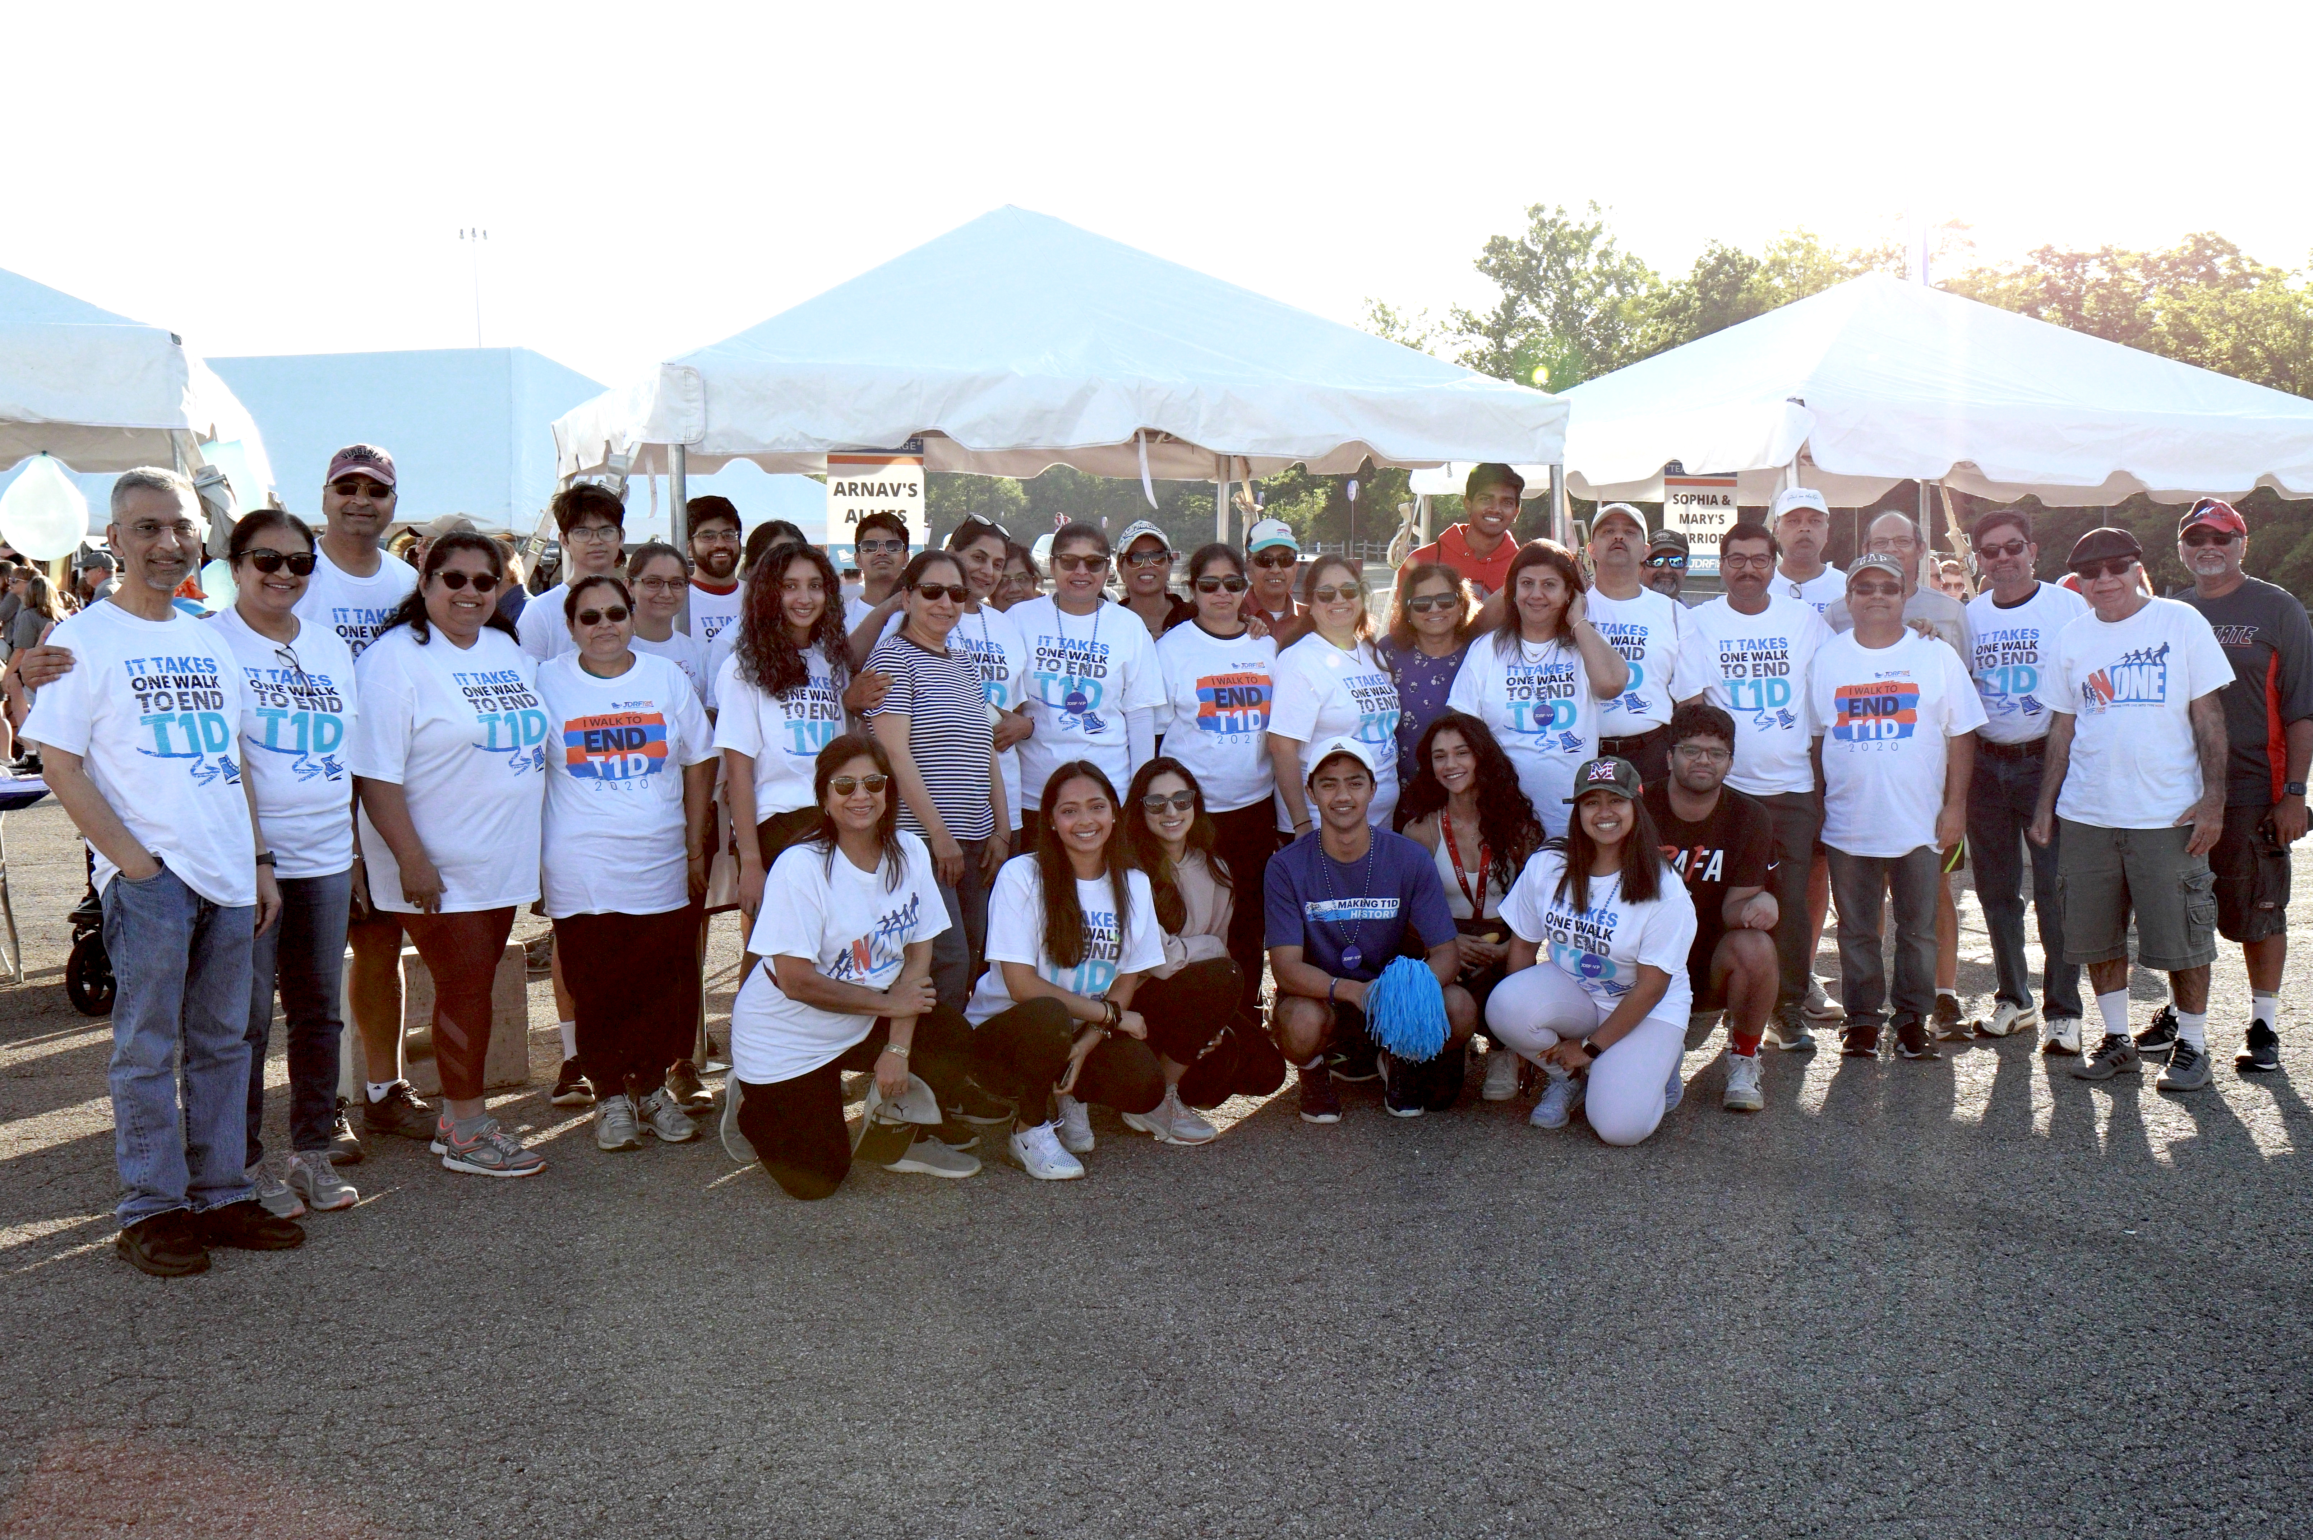

How to Get Involved with JDRF
SPONSORSHIP
FORM A TEAM
VOLUNTEER
JDRF will work to create a partnership that works best for your company
Boost morale and engage your
entire employee base
Lots of ways to get involved:
Walks, Galas, Advocacy, Outreach, Leadership, Networking,
Clinical Trials Participation

Slide 54
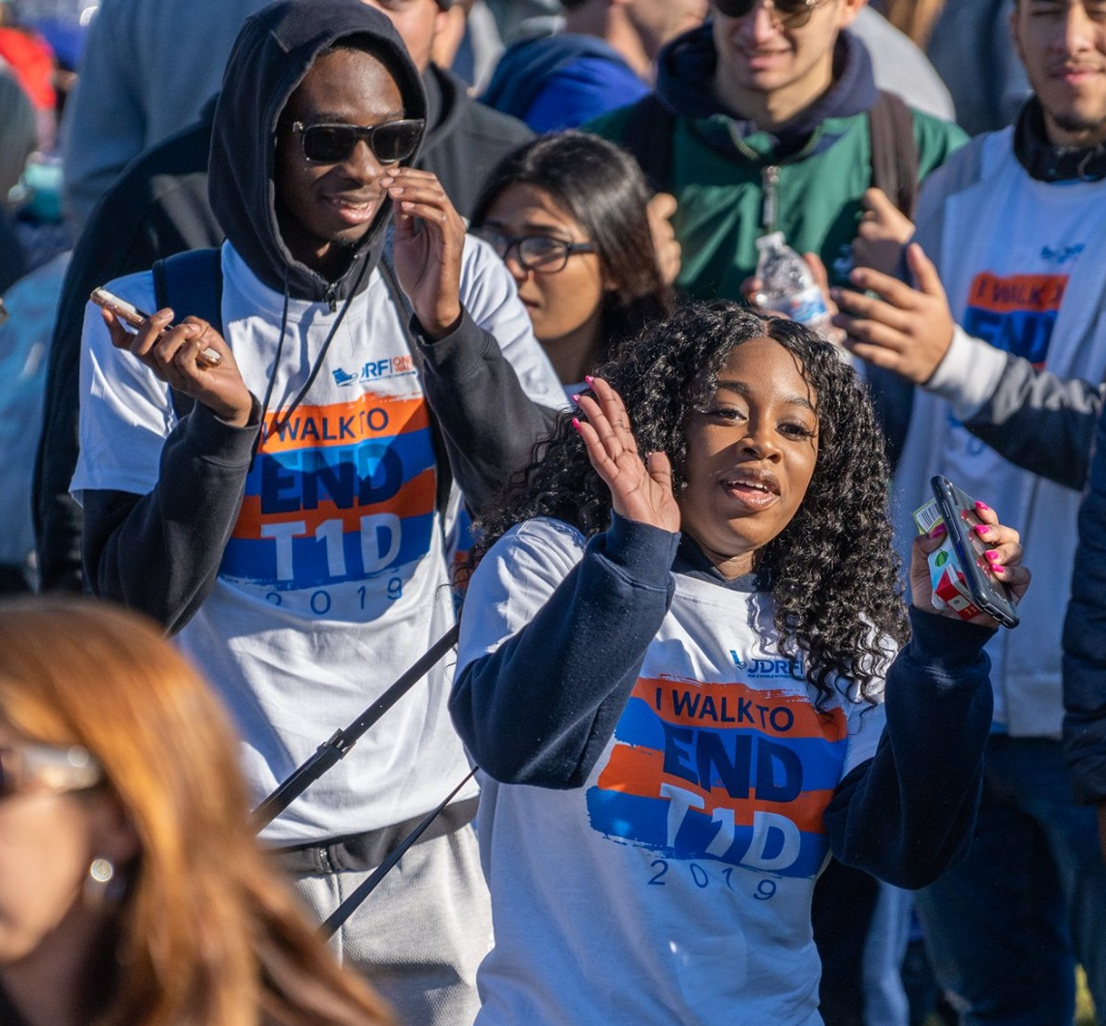
JDRF One Walk
Turning type one into type none
120+ events
in U.S.
500,000+
people
15,000+
family teams
3,000+
corporate teams

Slide 55
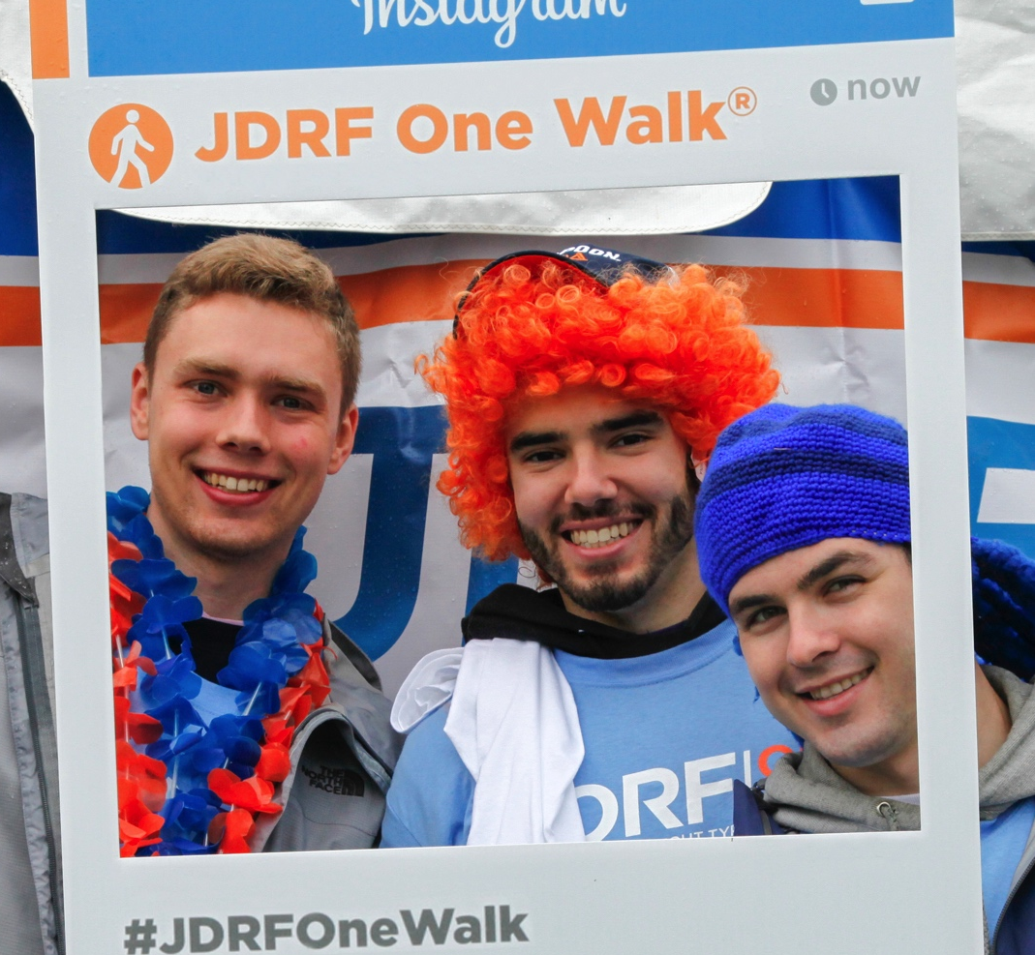
Join Us!
Enhances your brand in
the community
Healthy & fun employee engagement activity
Builds employee team spirit
Boosts employee moral
Enhances workplace relationships

Slide 56
REGISTER TODAY
walk.jdrf.org

